Slide 1

Go, change the world
RV College of
Engineering
Broadband Wireless –LTE 4G
OFDM transmitter and receiver Using Matlab
By
USN:1RV17EC077 M PRANEETH REDDY
USN:1RV17EC103 PRADYUMNA C

Slide 2
TABLE OF CONTENTS
1.INTRODUCTION
2.APPLICATIONS
3.ADVANTAGES
4.DISADVANTAGES
5.BLOCK DIAGRAM
6.MATLAB CODE
7.SIMULATION RESULTS

Slide 3

Go, change the world
RV College of
Engineering
INTRODUCTION
OFDM is a frequency-division multiplexing (FDM) scheme used as a digital multi-carrier modulation method.
It was introduced by Chang of Bell Labs in 1966.
Each subcarrier (signal) is modulated with a conventional modulation scheme at a low symbol rate.
This maintains total data rates similar to conventional single-carrier modulation schemes in the same bandwidth.
The main advantage of OFDM over single-carrier schemes is its ability to cope with severe channel conditions (for example, attenuation of high frequencies in a long copper wire, narrowband interference and frequency-selective fading due to multipath) without complex equalization filters.

Slide 4

Go, change the world
RV College of
Engineering
APPLICATIONS
Power line communication (PLC)
The wireless LAN (WLAN) radio interfaces IEEE 802.11a, g, n, ac, ah and HIPERLAN/2
The mobile broadband wireless access (MBWA) standard IEEE 802.20
The terrestrial mobile TV systems DVB-H, T-DMB, ISDB-T and MediaFLO forward link
Wi-fi and Wi-Max

Slide 5
Go, change the world
RV College of
Engineering
ADVANTAGES
High spectral efficiency as compared to other double sideband modulation schemes, spread spectrum, etc.
Can easily adapt to severe channel conditions without complex time-domain equalization.
Robust against narrow-band co-channel interference
Robust against intersymbol interference (ISI) and fading caused by multipath propagation
Efficient implementation using fast Fourier transform
Low sensitivity to time synchronization errors
Tuned sub-channel receiver filters are not required (unlike conventional FDM)
Facilitates single frequency networks (SFNs) (i.e. transmitter macrodiversity)

Slide 6
Go, change the world
RV College of
Engineering
DISADVANTAGES
Sensitive to Doppler shift
Sensitive to frequency synchronization problems
High peak-to-average-power ratio (PAPR), requiring linear transmitter circuitry, which suffers from poor power efficiency
Loss of efficiency caused by cyclic prefix/guard interval

Slide 7
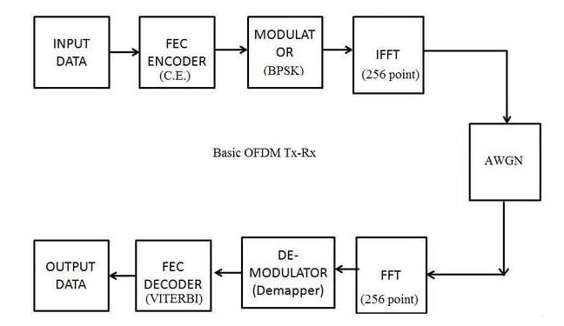
Go, change the world
RV College of
Engineering
FLOW DIAGRAM

Slide 8
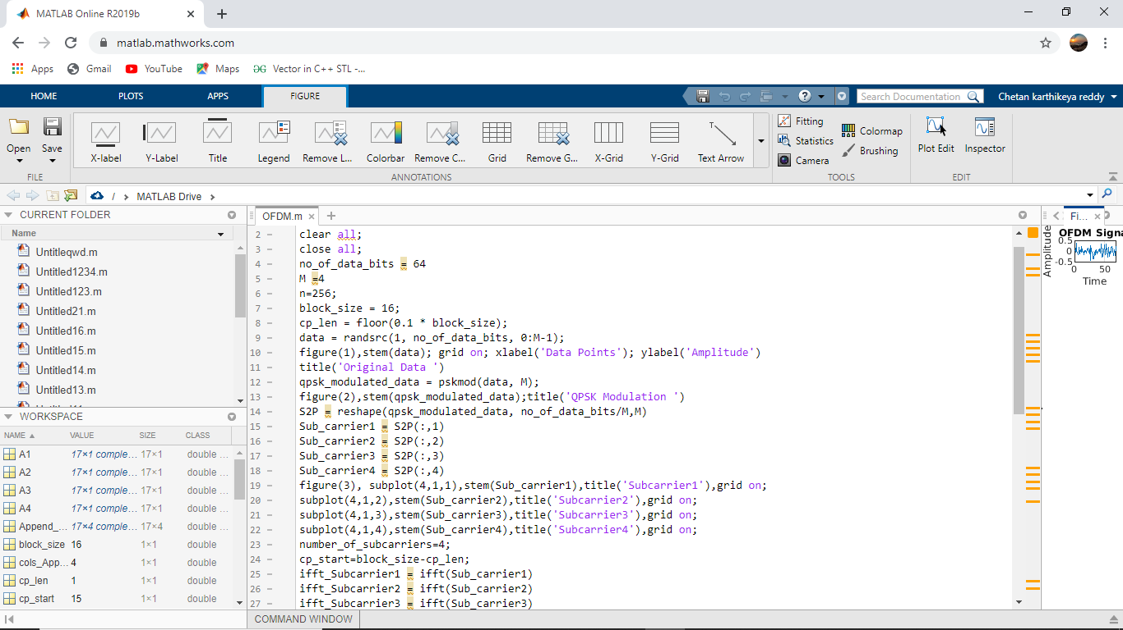
Go, change the world
RV College of
Engineering
MATLAB CODE

Slide 9
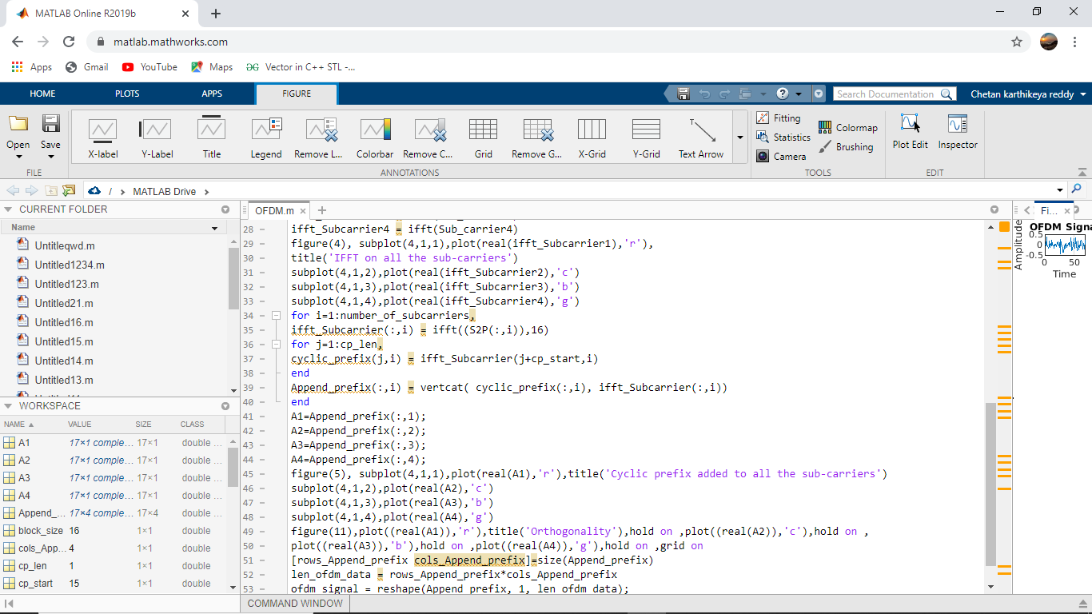
Go, change the world
RV College of
Engineering
MATLAB CODE

Slide 10
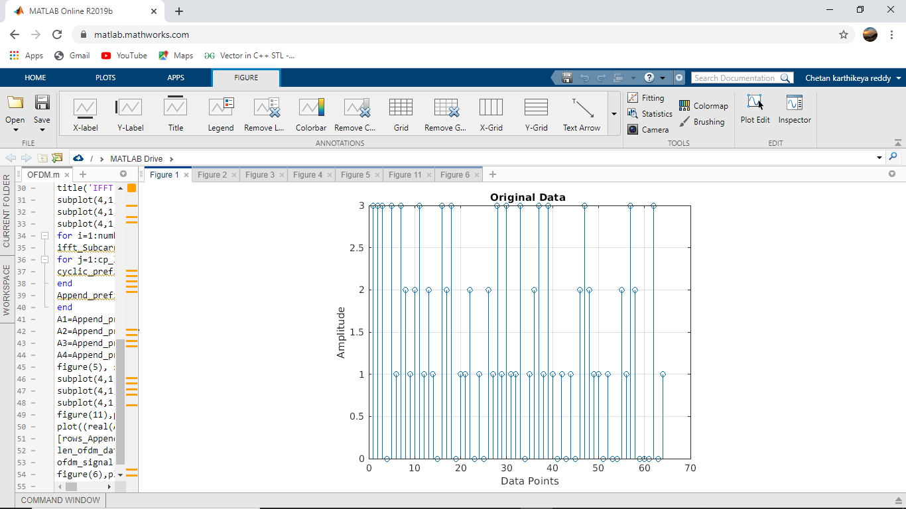
Go, change the world
RV College of
Engineering
MATLAB CODE

Slide 11
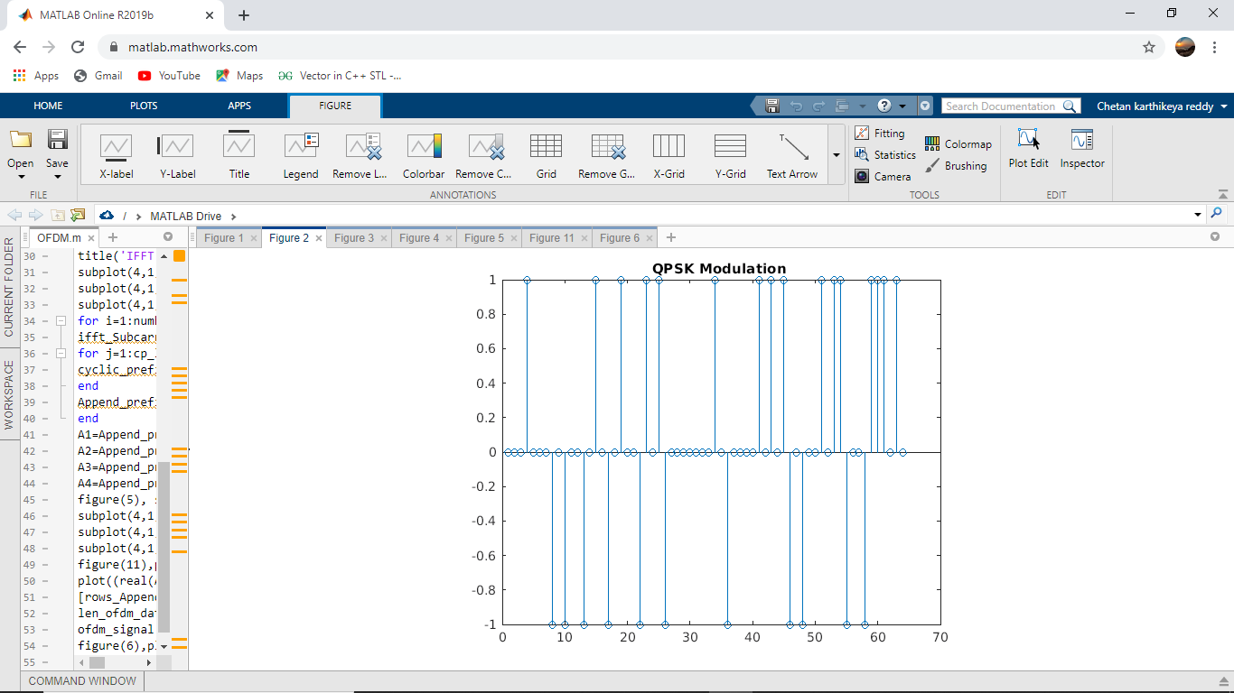
Go, change the world
RV College of
Engineering
QPSK MODULATION

Slide 12
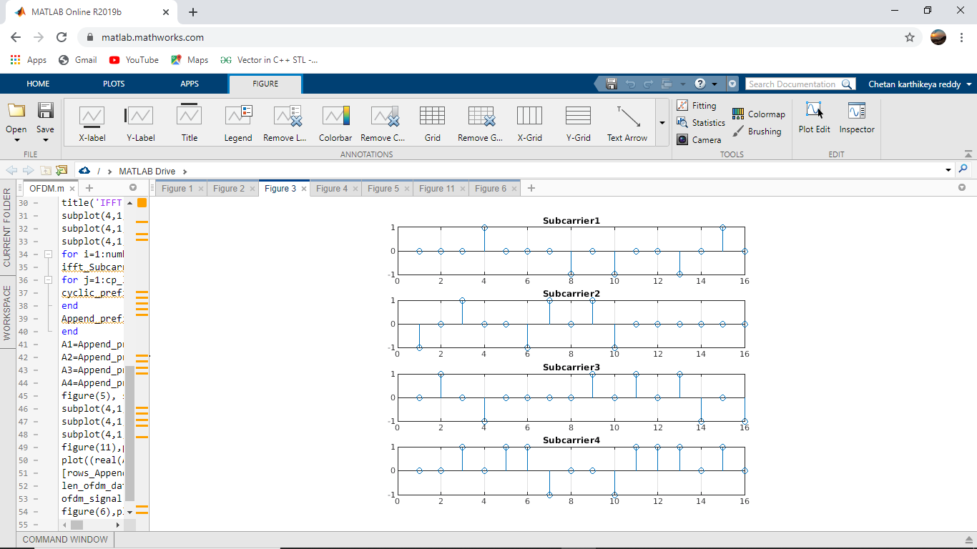
Go, change the world
RV College of
Engineering
SUB CARRIERS

Slide 13
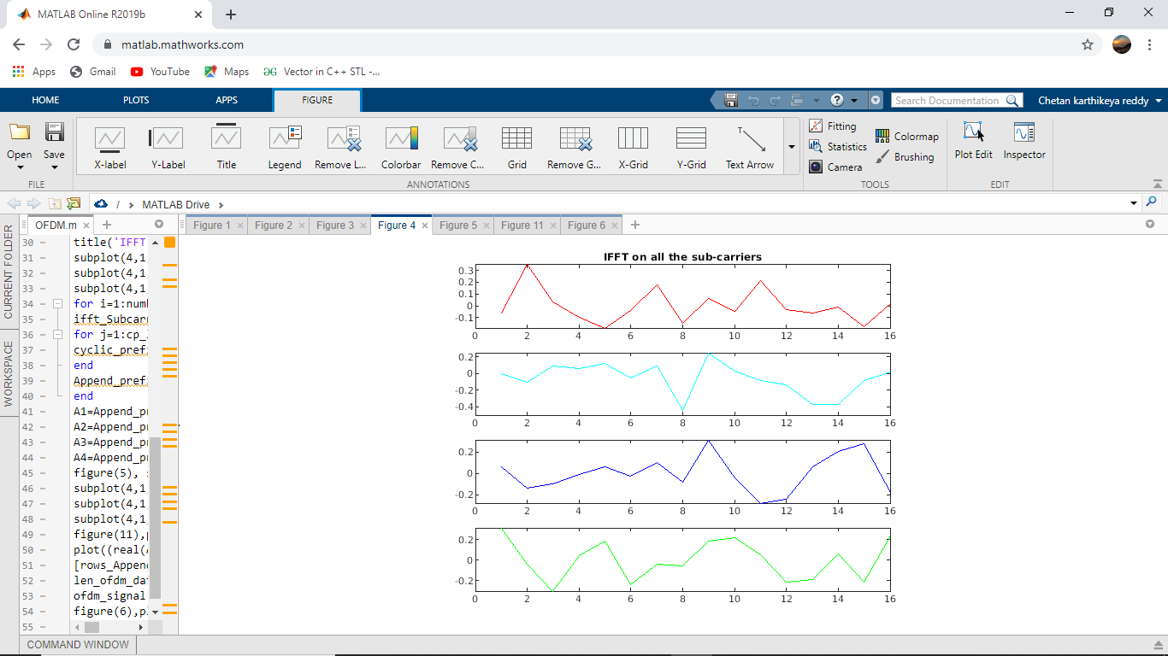
Go, change the world
RV College of
Engineering
IFFT ON ALL THE SUB CARRIERS

Slide 14
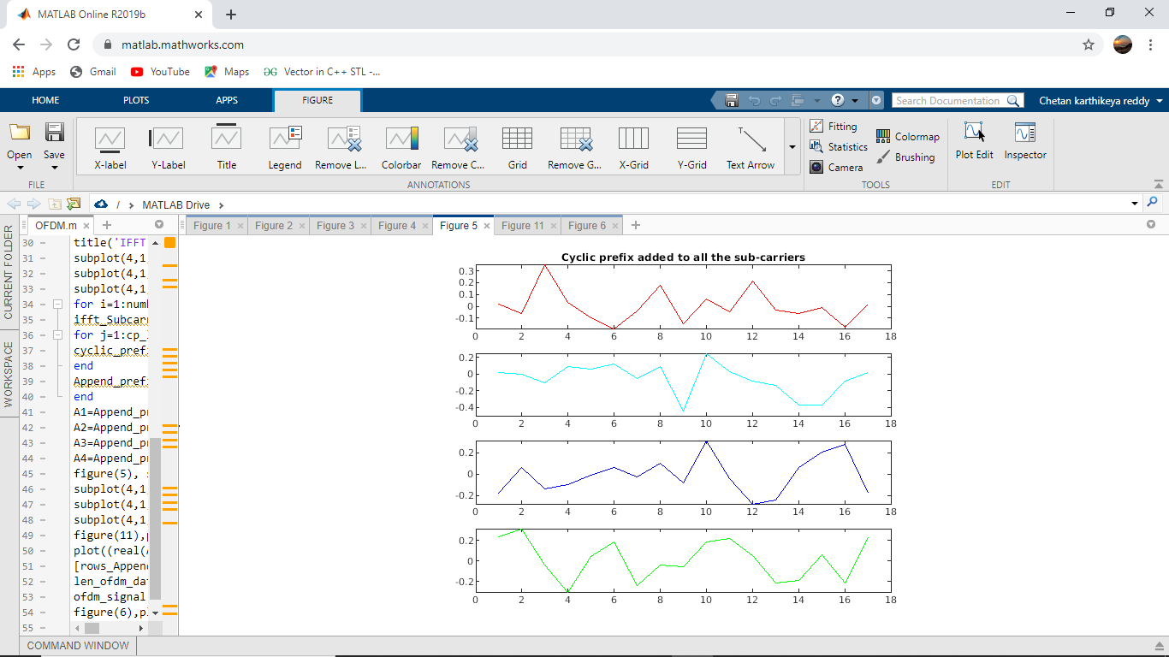
Go, change the world
RV College of
Engineering
ADDITION OF CYCLIC PREFIX TO ALL SUBCARRIERS

Slide 15
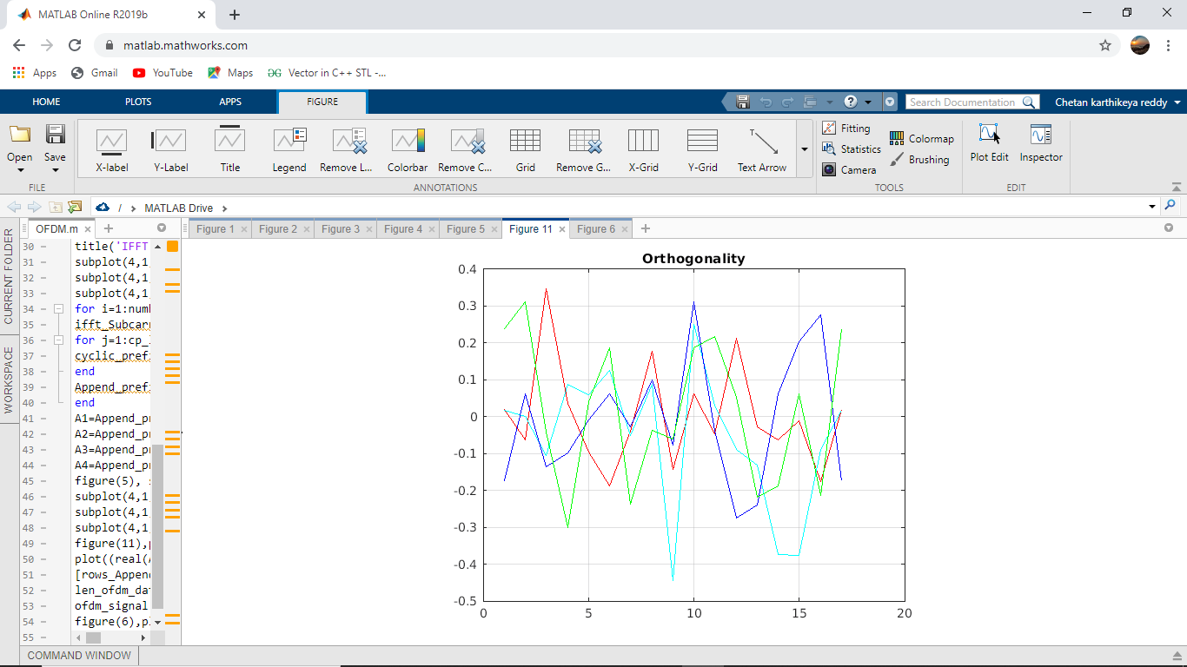
Go, change the world
RV College of
Engineering
ORTHOGONALITY

Slide 16
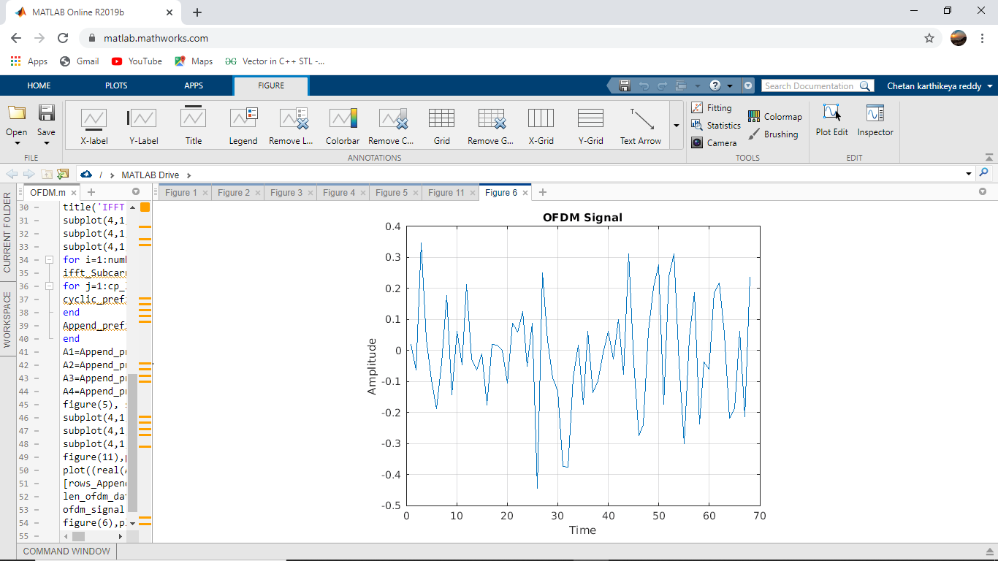
Go, change the world
RV College of
Engineering
OFDM SIGNAL

Slide 17
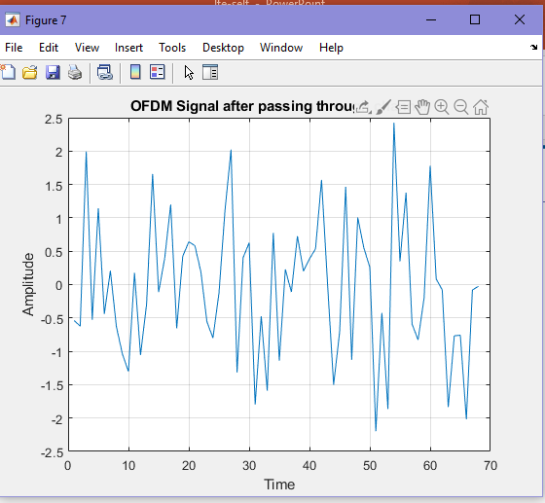
Go, change the world
RV College of
Engineering
AFTER PASSING THROUGH CHANNEL

Slide 18
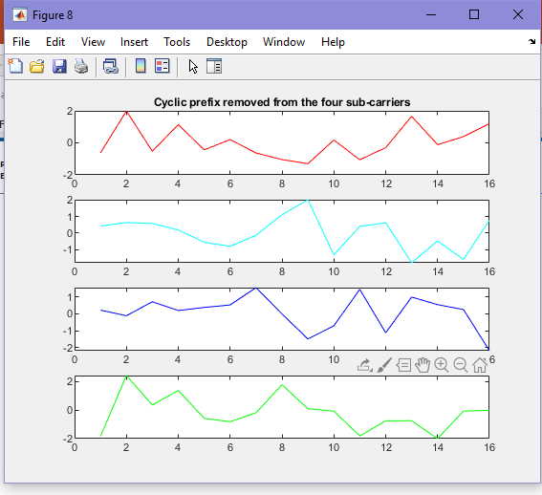
Go, change the world
RV College of
Engineering
AFTER REMOVING THE CYCLIC PREFIX

Slide 19
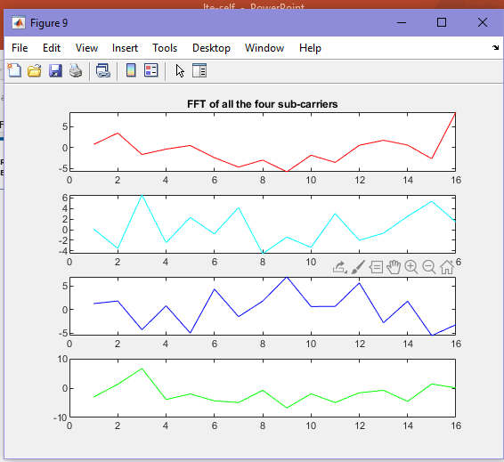
Go, change the world
RV College of
Engineering
AFTER FFT OF SUBCARRIERS

Slide 20
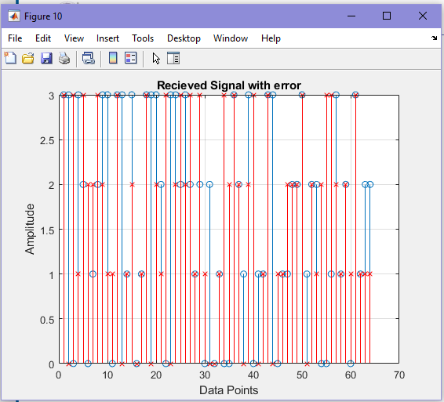
Go, change the world
RV College of
Engineering
RECEIVED SIGNAL

